Slide 1
Islamic Architecture
Minarets or towers
There was a mihrab or a prayer niche. The niche was on the inside in the direction of Mecca. The niches may have previously been used for setting the torah scrolls in synagogues for haikal churches
Domes or Cupolas
The muslims would use geometric shapes and repetitive art
Muqarnas (unique Arabic/Islamic space enclosing system) were used for the decoration of domes and other other places
Decorative islamic calligraphy, they would use calligraphy instead of pictures because they were forbidden in mosque architecture
Central fountains, which were used to wash your body with
Bright colors were commenly used

Slide 2
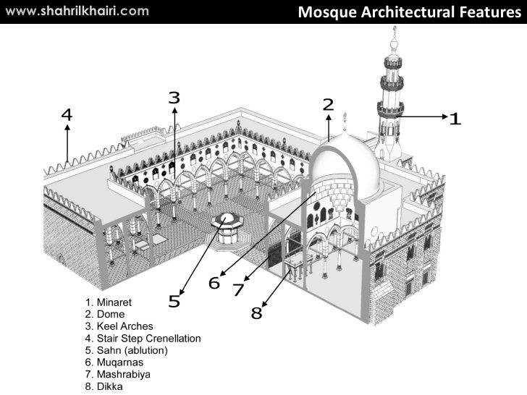

Slide 3
Qutb Minar
Construction of Qutb Minar was intended as a Victory Tower, to celebrate the victory of Mohammed Ghori over Rajput king, Prithviraj Chauhan, in 1192 AD,
By his viceroy, Qutbuddin Aibak, who later became the first Sultan of Delhi of Mamluk dynasty.
After the death of the commissioner, the Minar was added upon by his successor Iltutmish
later by Firoz Shah Tughlaq, a Tughlaq dynasty, Sultan of Delhi in 1368 AD.

Slide 4
Qutb Minar is perhaps the tallest brick minaret in the world, inspired by the Minaret of Jam in Afghanistan
It is an important example of early Afghan architecture, which later evolved into Indo-Islamic Architecture.
Qutb Minar is 72.5 metres (239 ft) high, has five distinct storeys, each marked by a projecting balcony carried on muqarnas corbel and tapers from a diameter 14.3 metres at the base to 2.7 metres at the top, which is 379 steps away.
It is listed as a UNESCO World Heritage Site along with surrounding buildings and monuments.

Slide 5
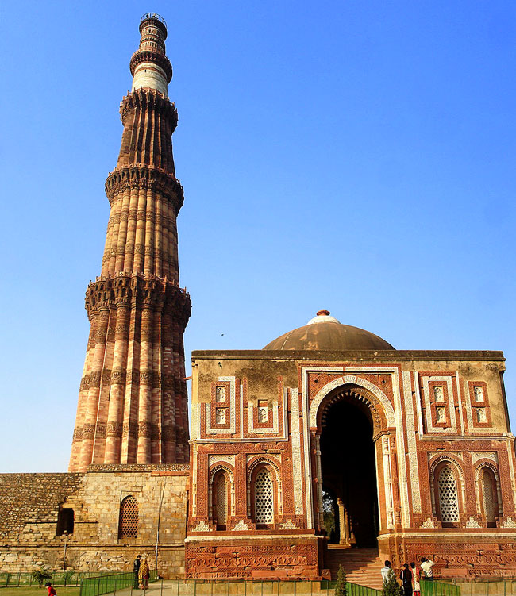

Slide 6
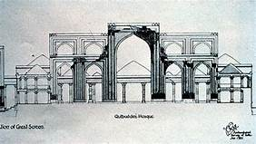
Alai Darwaza is the main gateway from southern side of the Quwwat-ul-Islam Mosque.
It was built by the second Khilji Sultan of Delhi, Ala-ud-din Khilji in 1311 AD.
Quwwat-ul-Islam Mosque
Located north-east of minar was built by Qutbu'd-Din Aibak in AD 1198.
It is the earliest extant mosque built by the Delhi Sultans.
It consists of a rectangular courtyard enclosed by cloisters, erected with the carved columns and architectural members of 27 Hindu and Jaina temples
which were demolished by Qutbu'd-Din Aibak as recorded in his inscription on the main eastern entrance.

Slide 7
Iron Pillar
This 4th-century pillar, originally made as a flagstaff in Vishnu’s honour, is a tribute to ancient Indian metallurgy.
This 7m-high pillar stands in the courtyard of the mosque and it was here a long time prior to the mosque’s construction.
A six-line Sanskrit inscription indicates that it was initially erected outside a Vishnu temple, possibly in Bihar, and was raised in memory of Chandragupta II, who ruled from AD 375 to 413.

Slide 8
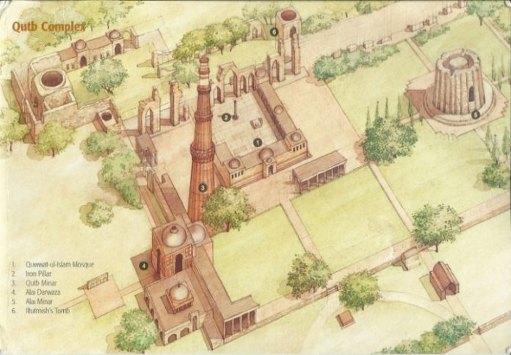

Slide 9
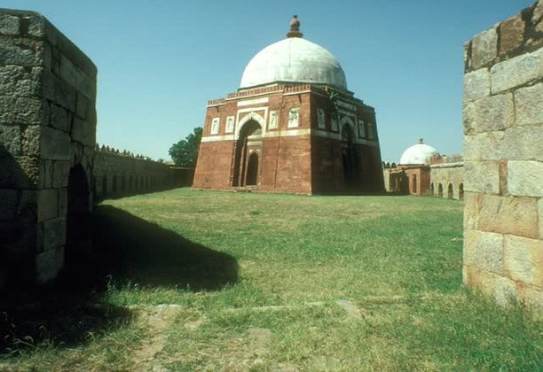
Mausoleum of Ghiyath al-Din Tughluq
a usually stone building with places for entombment of the dead above ground

Slide 10
The tomb complex has an oblique pentagonal plan
Square in plan, its battered walls are massive:
with an overall height of 24.4 meters
Its pointed dome, which rests on a transition of corner squinches
has an an interior diameter of 10.41 meters and an exterior diameter of 13.41 meters.
Crowned with a vase and melon (kalash and amala) finial, the dome follows the typology of Hindu temples in the Delhi region.
Three sides (north, south, and east) of the tomb have horseshoe-arched doorway openings with spearhead extrusions in their intrados and are flanked by a niche on either side.
A marble band begins at the base of these horseshoe arches, running across the architrave.

Slide 11
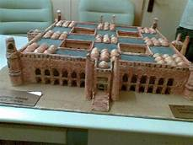
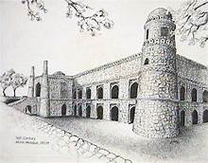
Khirki Masjid

Slide 12
Is located in the settlement of Jahanpanah, Delhi
Commissioned by by Khan-i Jahan Junan Shah, vizier to the Tughluq Sultan Firoz Shah (reg. 1351-1388).
Khirki, named for the perforated windows, or khirkis, that decorate the upper floors
has four open courtyards that provide light and ventilation to the internal prayer spaces.
Occupying an area of 87 square meters, the mosque is built on a raised platform with arched recessed openings (taikhana) that is 3 meters in height.
Unlike an open courtyard (hypostyle) congregational mosque,
Is square in plan, subdivided into quarters; each quarter has its own inner courtyard.

Slide 13
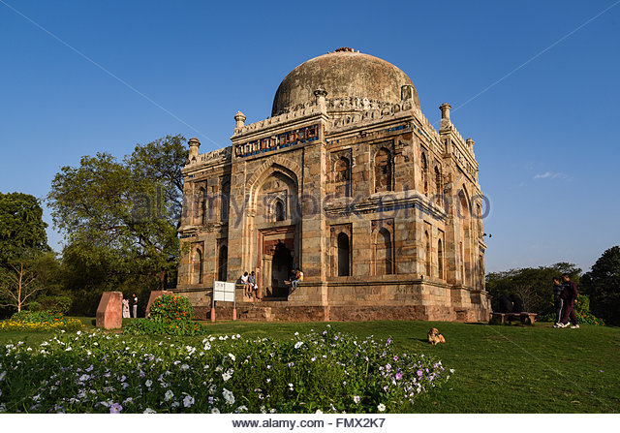
Shish gumbad tomb

Slide 14
Located in Lodi Garden, Delhi
Architecturally, this tomb follows the pattern of square Lodi tombs with a double storeyed appearance.
The ceiling is decorated with incised plaster work containing floral designs and Quranic inscriptions.
Originally, the monument was richly decorated with blue tiles.
It is not known who lies buried. here. It was perhaps built during Sikandar Lodi's reign (A.D. 1489-1517)

Slide 15
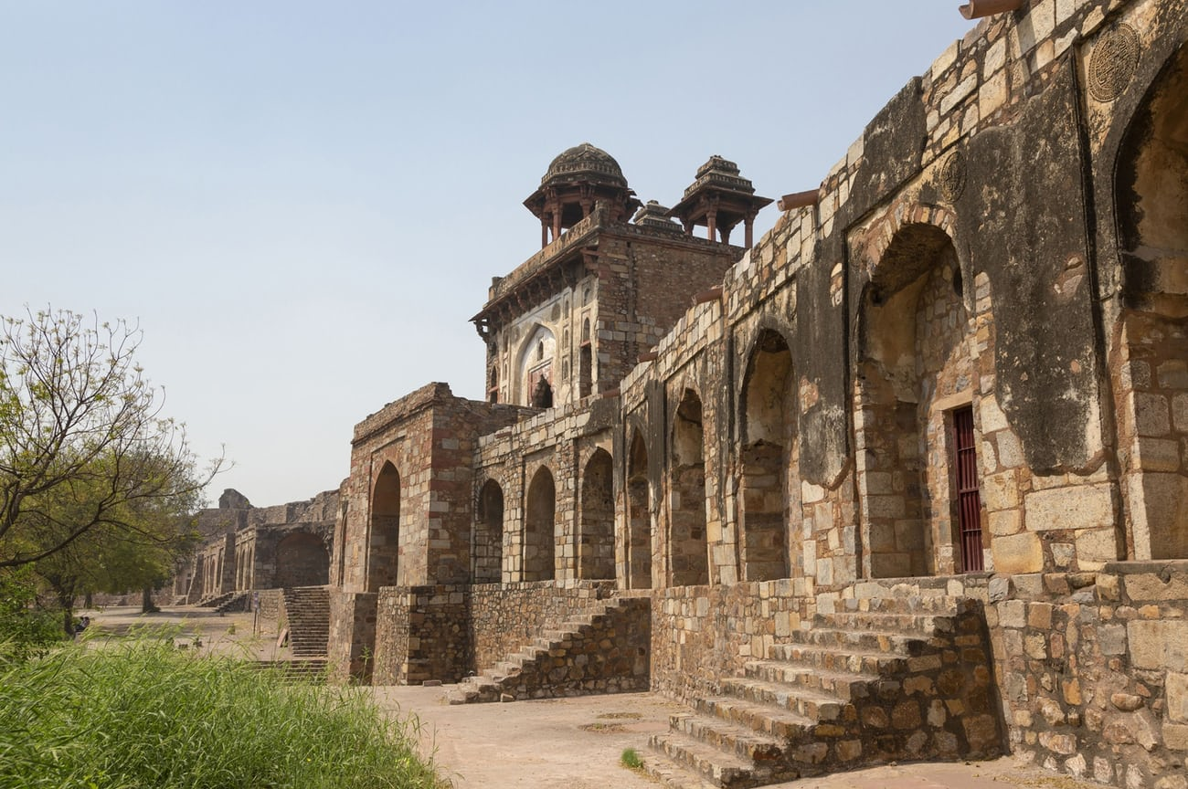
Purana Quila

Slide 16
Delhi’s history is often spoken of in terms of its seven cities
The sixth Delhi is the Purana Qila, or Old Fort, a 16th-century stone fort near the eastern edge of the city
The walls of the Qila, and the few structures within
a stepwell
a squat tower used as a library-cum-observatory, and a fine mosque –
are attributed to the Mughal emperor Humayun and the Afghan Sher Shah Suri (‘The Lion King’)

